Slide 1


Indian Wells Valley Water District
Celebrating more than 70 Years of Service
www.iwvwd.com
Special Board Meeting
October 16, 2025

Slide 2
October Board Meeting
1. Call to Order 2. Pledge of Allegiance 3. Roll Call 4. Posting of Agenda Declaration 5. Conflict of Interest Declaration 6. Public Questions and Comments on Closed Session This portion of the meeting is reserved for persons desiring to address the Board on any matter not on the agenda and over which the Board has jurisdiction. However, no action may be taken by the Board of Directors on any item not appearing on the agenda. Non-agenda speakers are asked to limit their presentation to five minutes. Public questions and comments on items listed on the agenda will be accepted at any time the item is brought forth for consideration by the Board. When you are recognized by the chairperson, please state your name for the record.

Slide 3
October Board Meeting
7. Closed Session

Slide 4
October Board Meeting
8. Public Questions and Comments This portion of the meeting is reserved for persons desiring to address the Board on any matter not on the agenda and over which the Board has jurisdiction. However, no action may be taken by the Board of Directors on any item not appearing on the agenda. Non-agenda speakers are asked to limit their presentation to five minutes. Public questions and comments on items listed on the agenda will be accepted at any time the item is brought forth for consideration by the Board. When you are recognized by the chairperson, please state your name for the record.

Slide 5
Current Business/Committee Reports
9.A. Consent Calendar Description: Approval of Board Meeting Minutes and Accounts Payable Disbursements. 1. Approval of Minutes: i. September 8, 2025, Regular Board Meeting ii. September 25, 2025, Special Board Meeting 2. Board Action: Approval of Accounts Payable Disbursements

Slide 6
Consent Calendar
Yes
No
Abstain
Boyd, Mallory | Yes
Griffin, Chuck | Yes
Kicinski, Ron | Yes
Rajtora, Stan | Yes
Saint Amand, David | Abs
5 / 5
Yes = 4 No = 0 Abstain = 1
Pass

Slide 7
October Board Meeting
9.B. Solar sites Security Upgrades Description: Presentation on Staff plan to upgrade security at several solar generation sites using advanced cameras and monitoring equipment

Slide 8
Infrastructure Needed to Install Cameras at Wells 30, 31, 33, and 34 (Totals)
5 Towers $10,000 total.
Concrete, Rebar, and Forms $7,500 total.
Electrical $1,200 total.
Communication Cable $400 total.
Equipment Rental $2,068.11 total.
Labor (In-House) $31,841.60 total.

Slide 9
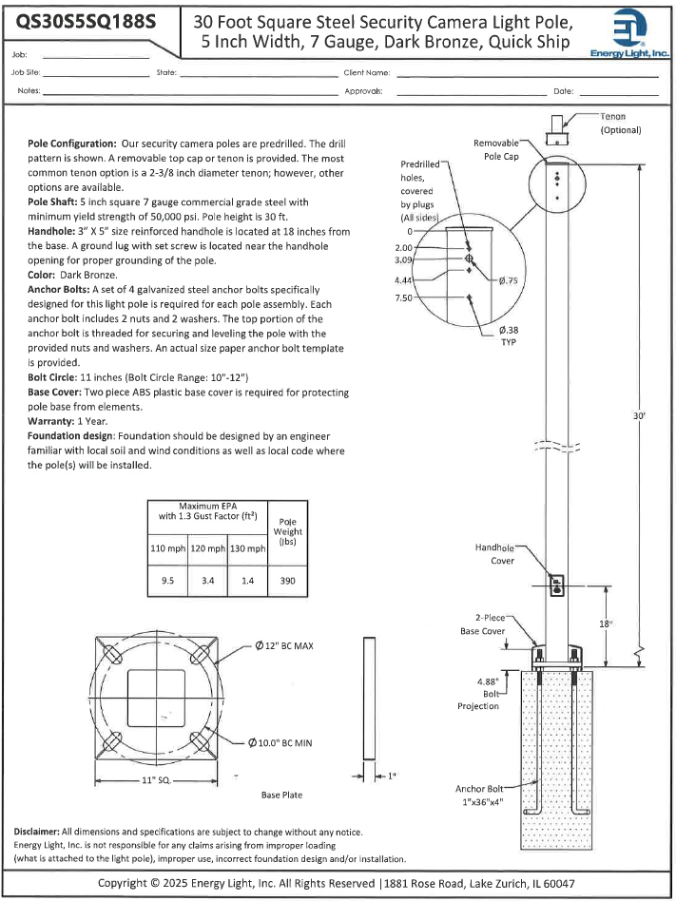
Camera Pole

Slide 10

Camera Hardware Purchase
Well 30 $20,734.64 (Quote 58464)
Well 31 $10,296.30 (Quote 58613)
Well 33 $5,042.86 (Quote 58621)
Well 34 $5,042.86 (Quote 58612)

Slide 11
Solar Panel Damage Remediation
Opterra Energy Services total $108,167.23
Well 30 = $74,916
Well 31 = 16,319.15
Well 33 = 16,393.70

Slide 12

Costs
Infrastructure & Labor = $53,009.71
Camera Hardware = $41,116.66
Miscellaneous = $9,412.63
Camera total = $103,539
Solar Panel Damage Remediation = $108,167.23
Estimated total Cameras and Panel repair = $211,706.23
$108,167.23 (repairs) covered by Insurance
$103,539 (security) funded by CIP budget of $125,000
Annual Cost (4 sites) = $2,719.56 for 1yr renewal

Slide 13
Security Cameras
Yes
No
Abstain
Boyd, Mallory | Yes
Griffin, Chuck | Yes
Kicinski, Ron | Yes
Rajtora, Stan | Yes
Saint Amand, David | Abs
5 / 5
Yes = 4 No = 0 Abstain = 1
Pass

Slide 14
Comprehensive Adjudication
9.C. Comprehensive Adjudication Description: Report and Discussion regarding the status of the Comprehensive Adjudication.

Slide 15
IWVGA
9.D. IWVGA Meeting Report Description: Report and discussion regarding meetings of the Indian Wells Valley Groundwater Authority (IWVGA). Including, Board discussion and consideration of issues of importance requiring action by the IWVGA. Board Action: No Action Required IWVGA Replenishment Fee Data on next slide Next Meeting: November 12, 2025

Slide 16
IWVGA 2023 Replenishment Fee Audit Results
9.D. IWVGA Meeting Report (cont.) IWVWD Replenishment Fee Paid Through 2023 – $11,013,801 2023 Audit Replenishment Cash Balance – $5,739,968 2023 Audit Pumping Owed to Replenishment – $2,485,871 2023 Audit Balance – $2,787,962 2023 Groundwater Management Exp - $324,599 2023 General Administrative Exp - $886,139 Other Expenses Should be in Previous Audits

Slide 17
Current Business (cont.)
9.E. Job Descriptions Revisions 1. Board to review the proposed revisions to two job descriptions to encompass requirements for a “Chief Operator” as defined in California Code of Regulations, Title 22, Chapter 13. 2. Board Action: Approve or dis-approve proposed job descriptions

Slide 18
Job Description Revisions
Yes
No
Abstain
Boyd, Mallory | Yes
Griffin, Chuck | Yes
Kicinski, Ron | Yes
Rajtora, Stan | Yes
Saint Amand, David | Abs
5 / 5
Yes = 4 No = 0 Abstain = 1
Pass

Slide 19
Current Business (cont.)
9.F. California Broadband Cooperative (CBC) Amendments to Bylaws Description: Board to review proposed amendments to the CBC bylaws. Board Action: Approve or disapprove proposed amendments.

Slide 20
CA Broadband Bylaw Amendments
Yes
No
Abstain
Boyd, Mallory | Yes
Griffin, Chuck | Yes
Kicinski, Ron | Yes
Rajtora, Stan | Yes
Saint Amand, David | Abs
5 / 5
Yes = 4 No = 0 Abstain = 1
Pass

Slide 21
Current Business (cont.)
9.G.1. Plant & Equipment Committee 1. Metal Building Purchase Description: Staff to present quotes for purchase of new metal building for pipe storage. Committee Recommends the Following: Purchasing the new steel building from Fortify Building Solutions in the amount of $83,899.33 Board Action: Approve or disapprove purchase

Slide 22
Purchase of Metal Building
Yes
No
Abstain
Boyd, Mallory | Yes
Griffin, Chuck | Yes
Kicinski, Ron | Yes
Rajtora, Stan | Yes
Saint Amand, David | Abs
5 / 5
Yes = 4 No = 0 Abstain = 1
Pass

Slide 23
Current Business (cont.)
9.G. Plant and Equipment Committee 2. Dune 3 Water Company Consolidation: Approval to Proceed to Bid Description: Staff to request Board approval to proceed to bid this project. Committee Recommends the Following: Board authorize proceeding to bid this project. Board Action: Approve or disapprove proceeding to bid

Slide 24
Dune 3 Proceed to Bid
Yes
No
Abstain
Boyd, Mallory | Yes
Griffin, Chuck | Yes
Kicinski, Ron | Yes
Rajtora, Stan | Yes
Saint Amand, David | Abs
5 / 5
Yes = 4 No = 0 Abstain = 1
Pass

Slide 25
Current Business (cont.)
9.H.1. Admin Exec Committee Description: Board to review and consider addition of a temporary position for a Construction Inspector and approve proposed job description and salary range. Committee Recommends the Following: Defer to Board for discussion. (No quorum at committee meeting) Board Action: Approve or disapprove job description (Note: this position will be one of three positions already approved by the Board)

Slide 26
Approval of Inspector Job Description
Yes
No
Abstain
Boyd, Mallory | Yes
Griffin, Chuck | Yes
Kicinski, Ron | Yes
Rajtora, Stan | Yes
Saint Amand, David | Abs
5 / 5
Yes = 4 No = 0 Abstain = 1
Pass

Slide 27
Current Business (cont.)
9.I. General Manager Compensation Description: Board to consider and adjustment to the General Manager’s compensation
Serving Our Community for over 70 Years

Slide 28
GM Compensation
Yes
No
Abstain
Boyd, Mallory | Yes
Griffin, Chuck | Yes
Kicinski, Ron | Yes
Rajtora, Stan | Yes
Saint Amand, David | Abs
5 / 5
Yes = 4 No = 0 Abstain = 1
Pass

Slide 29
GM Report Water District Data
9.J. GM Report Employee Injury Report NSTR Conservation WaterSmart data. 65 Conversations, 17 Field Visits Delinquent Account Lock-offs August = 62 Water Waste Incidents = 2,031 via WaterSmart, 17 Field visits
Serving Our Community for over 70 Years

Slide 30
GM Report Legislative Update
9.J. GM Report AB 1413 (Papan) 2 year bill, could return in Jan 2026 WD continues to be opposed unless amended Last language was not clear and Bill was delayed awaiting cancellation or revision 2 year bill, could return in Jan 2026 AB 1466 (Hart) Revised Bill supported by IWVWD Signed by Governor into law 10-11-2025
Serving Our Community for over 70 Years

Slide 31
GM Report Misc. Updates
9.J. 1. GM Report Update on leaks and water usage at both individual homes and landlord owned properties. ii. Update on Rand Communities Service District recovery efforts and potential mutual aid agreement. iii. Update on Inyo County Code Enforcement call. Allegations of trash on WD property in Inyo County.
Serving Our Community for over 70 Years

Slide 32
Board Member Requested Discussion Lawn Removal
9.J.2. Cash for Grass/Lawn Removal discussion Description: Board to discussion potential water savings of removing more lawns in the Valley.

Slide 33
GM Report Committee Meeting Updates
9.J.3. Committee Meeting updates Finance Committee – All items covered elsewhere in this briefing Plant and Equipment – All items covered elsewhere in this briefing Admin/Exec – All items covered elsewhere in this briefing Special Committee for Inyokern CSD (To Committee Members for Report)

Slide 34
GM Report WD Public Outreach
9.J.4. Upcoming NSTR Since the last Board Meeting Two Farmers Market Events Social Media WD Social Media focused on positive and productive community feedback, and conservation (California Water Professionals Appreciation Week) News Media GA has new FB page, no content as of last week Article on CSD Consolidation may have some errors
Serving Our Community for over 70 Years

Slide 35
Staff Updates Engineering
9.J.5. Water System Consolidations Update
Description: Update on District consolidations
Inyokern CSD: Ad-Hoc Committee Meetings
Rademacher
Dune 3 Mutual Water Company
Hometown Water Association
Serving Our Community for over 60 Years

Slide 36
Staff Updates Engineering
9.J.6. Brady Street Transmission Pipeline Replacement
Design phase for first section to Ward Ave. Base mapping completed.
Parts ordered.
Possible old pipe will be abandoned in place to speed up the project. Stay tuned.
Serving Our Community for over 60 Years

Slide 37
Staff Updates Financial
9.J.7. Recycled Water
Description: Update on Recycled Water
Serving Our Community for over 70 Years

Slide 38
Staff Updates Financial
9.J.8. Financial Status
Description: Report on the District’s current financial status.
Serving Our Community for over 70 Years

Slide 39
Financial Breakout
Serving Our Community for over 60 Years

Slide 40
Financial Breakout
Serving Our Community for over 60 Years

Slide 41
Staff Updates Operations
9.J.9. Arsenic Treatment Facilities
Description: Staff will update the Board on Maintenance Issues and production.
Arsenic Plant 1 produced a total of 5,908,000 gallons.
Arsenic Plant 2 produced a total of 16,475,000 gallons.
Serving Our Community for over 70 Years

Slide 42
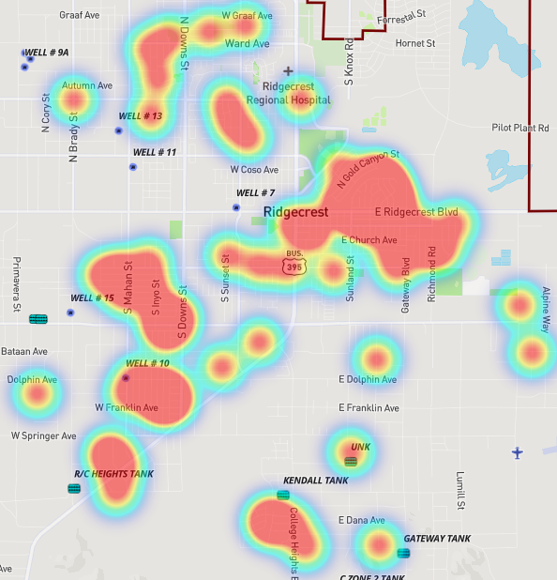
Staff Updates Operations
9.J.10. Operations
Description: Staff report on Operations
24 After hour calls
30 Repairs 33 Replacements
0 Hydrant repairs
1 Mineline Repair
Completed Phase I of Mahan St. Phase II is now
underway. (City of Ridgecrest Measure V)
Serving Our Community for over 70 Years

Slide 43
Staff Updates Operations
9.J.10. (cont.) Operations
Description: Staff report on Operations
16 Valves Exercised (347 YTD)
0 NO-DES = (9,567,665g YTD)
USA Locates
188 USA North Tickets (1,239 Marked Tickets YTD)
1 USA South Tickets (36 Marked Tickets YTD)
The District has two new certified operators.
Daniel Beardsley: Welding Certification-3G
Robert Renfroe: Class B Commercial Driver License
Serving Our Community for over 70 Years

Slide 44
Board Comments/Future Agenda Items
Date of Next Regular Board Meeting:
November 10, 2025
Adjournment
Serving Our Community for over 70 Years

