Slide 1


Indian Wells Valley Water District
Celebrating more than 70 Years of Service
www.iwvwd.com
Regular Board Meeting
& Public Hearing
February 10, 2025

Slide 2
February Board Meeting
1. Call to Order 2. Pledge of Allegiance 3. Roll Call 4. Posting of Agenda Declaration 5. Conflict of Interest Declaration 6. Public Questions and Comments on Closed Session This portion of the meeting is reserved for persons desiring to address the Board on any matter not on the agenda and over which the Board has jurisdiction. However, no action may be taken by the Board of Directors on any item not appearing on the agenda. Non-agenda speakers are asked to limit their presentation to five minutes. Public questions and comments on items listed on the agenda will be accepted at any time the item is brought forth for consideration by the Board. When you are recognized by the chairperson, please state your name and address for the record.

Slide 3
February Board Meeting
7. Closed Session

Slide 4
February Board Meeting
8. Public Questions and Comments This portion of the meeting is reserved for persons desiring to address the Board on any matter not on the agenda and over which the Board has jurisdiction. However, no action may be taken by the Board of Directors on any item not appearing on the agenda. Non-agenda speakers are asked to limit their presentation to five minutes. Public questions and comments on items listed on the agenda will be accepted at any time the item is brought forth for consideration by the Board. When you are recognized by the chairperson, please state your name and address for the record.

Slide 5
2023-2024 Audit Report
9. Presentation by CJ Brown & Associates: 2023-2024 Audit Report Description: Presentation by Chris Brown of the final 2023-2024 Audit Report.

Slide 6



Indian Wells Valley
Water District
Board of Directors
Presentation Of The June 30, 2024
Annual Audited Financial Statements
C.J. Brown & Company, CPAs
An Accountancy Corporation

Slide 7
Management Report
Auditors Communication to the Board
  Auditor’s Responsibility Under U.S. Governmental Audit Standards.
  Discuss Deficiencies and Material Weaknesses Noted in the District’s Internal Controls Based on Our Test Samples - None Noted
  Discuss the District’s Accounting Practices
  Corrected and/or Uncorrected Adjustments
  Any Difficulties Encountered in Performing the Audit – None Noted
  Any Disagreements with Management – None Noted

Slide 8
Auditor’s Opinion
Independent Auditor’s Report
Unmodified Opinion
  In our opinion, the financial statements referred to above present fairly, in all material respects, the financial position of the Indian Wells Valley Water District as of June 30, 2024….

Slide 9
Financial Highlights

Slide 10


Slide 13

Questions

Slide 14
Public Hearing
A. Presentation of the Cost-of-Service Study by Mark Hildebrand of Hildebrand Consulting.

Slide 15
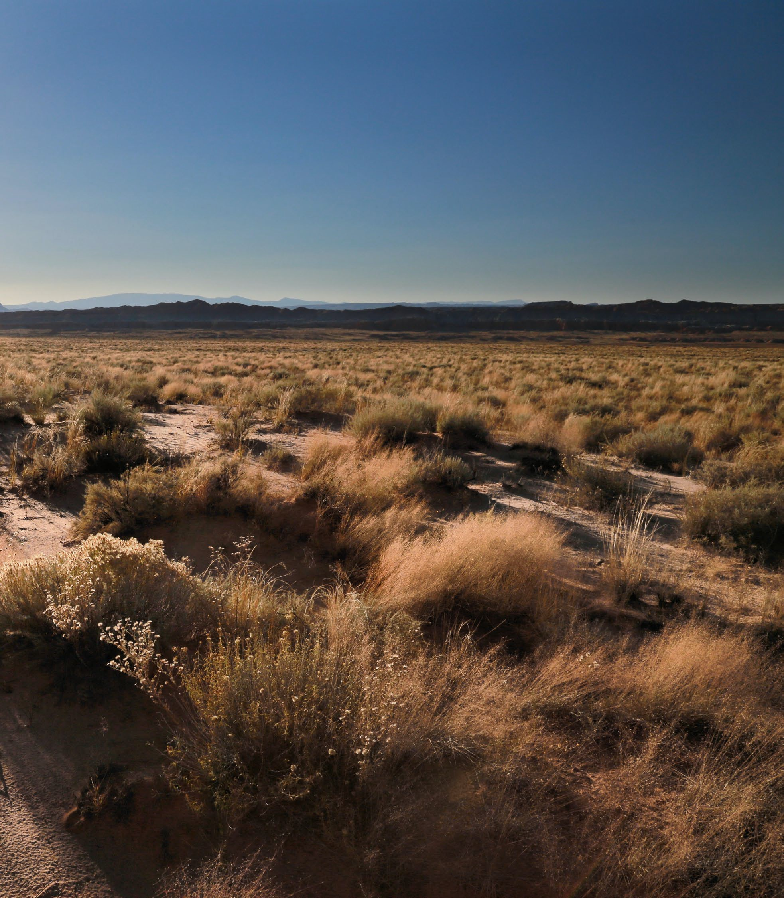

Indian Wells Valley Water District 2024 Rate Study
Public Hearing
Board Meeting February 10, 2025

Slide 16
Agenda
Scope of Work and Objectives
Financial Plan Findings
Project Schedule
2

Slide 17




The Rate Setting Process
Compares the revenues of the utility to its expenses to determine the overall level of rate adjustment
Revenue Requirements
Cost-of-Service*
Equitably allocates the revenue requirements between the various customer classes of service
Design rates for each class of service to meet the revenue needs of the utility, along with any other rate design goals and objectives
Rate Design*
* Not included in scope of work because findings from last study are still applicable.
3

Slide 18
Legal Requirements
for Setting Water Rates In California
Proposition 218 (Article XIIID, Section 6 of California Constitution)
Revenues shall not exceed funds required to provide service; nor used for another purpose
Amount shall not exceed the proportional cost of the service attributable to the parcel
Service must be actually used or immediately available
Approval process includes 45-day notice, public hearing, and written majority protest. Does not require a voting process (unlike taxes).

Slide 19
Financial Plan

Slide 20
Revenue
FY2024/25 Budget
Rate Revenue | $13,357,000
GSA Fees | $3,139,000
Bulk and Construction Water | $156,000
Non-Rate Revenue Miscellaneous Fees | $430,000
Interest Earnings | $125,000
Capital Facility Fees | $100,000
Miscellaneous Fees 2.5%
Capital Facility Fees 0.6%
Operating Revenue 0.3%
Bulk and Construction Water 0.9%
Interest Earnings 0.7%
GSA Fees 18.1%
Rate Revenue 77.0%
Operating Revenue $47,000
Total: $17,354,000

Slide 21
Operating and Debt Expenses
FY2024/25 Budget
Source of Supply 9.5%
Legislative Expenses 0.7%
Source of Supply | $1,623,000
Legislative Expenses | $119,000
Field Services | $571,000
Conservation | $34,000
Transmission & Distribution | $2,062,000
Customer Service | $517,000
Engineering | $554,000
General Administration | $2,758,000
Legal/Adjudication | $1,600,000
Arsenic Treatment | $457,000
Non-Operating Expenses | $293,000
GSA | $3,261,000
Alternate Water Supply | $77,000
OPEB | $233,000
Field Services 3.4%
OPEB 1.4%
Conservation 0.2%
Debt Service 16.8%
Transmission & Distribution 12.1%
Alternate Water Supply 0.5%
GSA 19.2%
Customer Service 3.0%
Engineering 3.3%
Non-Operating Expenses 1.7%
General Administration 16.2%
Debt Service $2,862,000
Total Budget: $17,021,000 *
Arsenic Treatment 2.7%
Legal/Adjudication 9.4%
* Does not include capital spending. All operating costs are assumed to inflate by 3% per year for the next 10 years.
7

Slide 22
Reserve Policies
Reserve policies are important for protecting the District against unforeseen circumstances, stabilizing revenue requirements, and contributing towards the District’s credit rating. The following reserve targets are proposed by this Study and are consistent with recent District practices.
Operating Reserve
< 6 month of operating budget (current target: $5.5 million)
Capital Improvement Reserve
Target: $10.8 million (cost of one well, one booster station and one storage tank)
Vehicle Reserve
Policy: $350,000
Computer Replacement Reserve
Policy: $100,000
8

Slide 23
Capital Projects
*
FY 2025
FY 2026
FY 2027
FY 2028
FY 2029
Water Supply
Well Rehabilitation |  |  | $300,000 | $300,000 | $300,000 | $300,000
New Well Development
Miscellaneous Water Supply |  | $145,000 | $1,167,500 | $1,097,500 | $1,035,000 | $110,000
 | TOTAL WATER SUPPLY | $145,000 | $1,467,500 | $1,397,500 | $1,335,000 | $410,000
Transmission and Distribution
Springer 24" Line La Mirage Mainline Replacements |  |  | $3,400,000 | $1,375,000 | $1,375,000 | $1,375,000
Inyokern 30" |  | $6,000,000
Miscellaneous T&D |  | $216,500 | $691,500 | $516,500 | $266,500 | $266,500
TOTAL TRANSMISSION & DISTRIBUTION |  | $6,216,500 | $4,091,500 | $1,891,500 | $1,641,500 | $1,641,500
TOTAL TECH |  | $22,000 | $115,000 | $30,000 | $15,000 | $15,000
TOTAL GENERAL PLANT |  | $35,000 | $535,000 | $625,000 | $545,000 | $145,000
TOTAL FUTURE SOURCE OF SUPPLY |  | $314,000 | $0 | $0 | $0 | $0
TOTAL CAPITAL PROGRAM: |  | $6.7M | $6.2M | $3.9M | $3.5M | $2.2M
* All costs expressed in 2024 dollars
* Annual capital spending starting in FY2030 are assumed to be $5.0 million (in 2024 dollars)
9

Slide 24
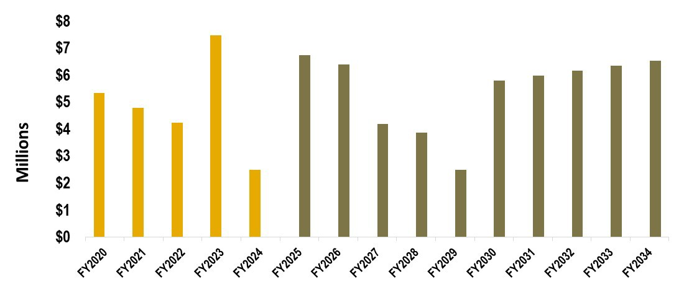
Projected Capital Spending
Recent Average:
$4.2M
Forecasted Average:
$5.3M
10

Slide 25











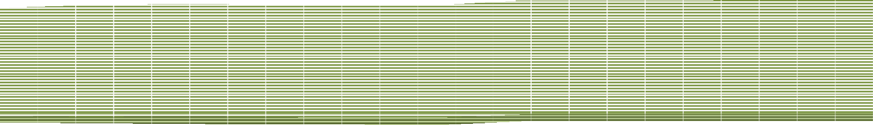





Cash Flow Forecast based on Proposed Rate Increases
Total Revenue / Expenses ($M)
$30
Additional Rate Revenue
$25
Existing Rate Revenue
$20
Non-Rate Revenue
$15
GSA Fee Revenue
$10
Expenses
Revenues
Cash Capital
$5
Debt Service
Debt Service
$0
Operating Expenses
FY2024
FY2025
FY2026
FY2027
FY2028
FY2029
FY2030
FY2031
FY2032
FY2033
FY2034
GSA Fee Expenses
Projected Ending Fund Balance
Reserve Targets
Minimum Reserves
MILLIONS
$30
$20
$10
$0
FY2024
FY2025
FY2026
FY2027
FY2028
FY2029
FY2030
FY2031
FY2032
FY2033
FY2034
12.0%** | 10.0% | Proposed 8.0% | 8.0% | 8.0% | 4.0% | 4.0% | Projected 4.0% | 4.0% | 4.0%
Rate Revenue Increase*:
Debt Coverage Ratio:
Net Debt Proceeds:
1.06 1.49 1.79 2.05 2.35 3.24 3.43 3.62
3.82
3.99
* First proposed rate increases to be effective March 1 of 2025; subsequent rate increase will be on January 1.
** Replaces previously approved rate increase of 8% on January 1, 2025.
11

Slide 26
2022 Financial Plan vs. Current Financial Plan
Volumetric Revenue:
Total annual water usage during the 2022 Study was 2.43M HCF, which we assumed would remain the same.
Total annual water usage in FY2024 was 2.17M HCF, a 10.5% decrease.
This decrease has yielded a 19.4% shortfall in revenue.
This financial plan assumes that water usage will continue to decrease at 2.5% per year for 5 years
CIP spending from FY2025 through FY2029:
2022 Financial Plan assumed $16.0M
Current Financial Plan assumes $23.7M ($7.7M increase, or 48%)
Operating Costs:
Operating costs through FY2024 have been similar to those projected by the 2022 Financial Plan
The budgeted operating costs in FY2025 have jumped by 13% (compared to a 3% increase forecasted by the 2022 Study)
12

Slide 27
Year 1 Commodity Rates
(not to scale)
GSA Replenishment Costs ($5.25 / HCF)*
GSA Pumping Cost ($0.24 / HCF)*
20 HCF
District Costs ($2.21 / HCF)
Tier 1
$2.45
Tier 2
$7.70
Proposed: Current:
Change:
$2.21
$7.46
10.9%
3.2%
Percent of water sales:
76%
24%
13

Slide 28
PROPOSED RATE SCHEDULE (1 of 3)
CURRENT
Commodity Charges(per HCF)
Effective March 1, 2025
Commodity Charges(per HCF)
GSA Extraction Fee
District Commodity GSA Extraction _{Rep} ^{GSA}
District Rates
GSA Replenishment
Total
Rate Fee
lenishment
Total
Fee
Tier 1 $1.97 $0.24 $0.00 $2.21
Tier 2 $1.97 $0.24 $5.25 $7.46
Tier 1 $2.21 $0.24 $0.00 $2.45
Tier 2 $2.21 $0.24 $5.25 $7.70
Fixed Monthly Charges
Fixed Monthly Charges
Meter Size | Ready-to-Serve | Arsenic Charge | Total
3/4" | $38.56 | $11.10 | $49.66
1" | $59.27 | $18.50 | $77.77
1 1/2" | $111.03 | $37.01 | $148.04
2" | $173.14 | $59.22 | $232.36
3" | $338.82 | $118.42 | $457.24
4" | $525.18 | $185.04 | $710.22
6" | $1,042.86 | $370.08 | $1,412.94
8" | $1,664.07 | $592.13 | $2,256.20
 | Meter Size | Ready-to-Serve | Arsenic Charge | Total
 | 3/4" | $43.19 | $12.43 | $55.62
 | 1" | $66.38 | $20.72 | $87.10
 | 1 1/2" | $124.35 | $41.45 | $165.80
 | 2" | $193.92 | $66.33 | $260.25
 | 3" | $379.48 | $132.63 | $512.11
 | 4" | $588.20 | $207.24 | $795.44
 | 6" | $1,168.00 | $414.49 | $1,582.49
 | 8" | $1,863.76 | $663.19 | $2,526.95
10" $2,388.83 $851.18 $3,240.01
10" $2,675.49 $953.32 $3,628.81
Zone Charges
Construction Meter Charges
Zone Charges
Construction Meter Charges
Zone
Volumetric Charge
(per HCF)
Rates
Zone
Volumetric Charge
(per HCF)
Rates
Zone B Zone C Zone D
$0.29
$0.54
$0.83
Monthly Meter Charge:* $62.66
Volumetric Unit Rate (per HCF): $7.46
* May be pro-rated for partial months.
Zone B Zone C Zone D
$0.32
$0.60
$0.93
Monthly Meter Charge:* $70.18
Volumetric Unit Rate (per HCF): $8.36
* May be pro-rated for partial months.
Zone E $1.12
Zone E $1.25
Private Fire Service
Bulk Water Rates
Private Fire Service
Meter Size Monthly Charge
Bulk Water Rates
Meter Size Monthly Charge
Rates
Rates
1"
2"
3"
4"
6"
8"
$2.04
$12.65
$36.71
$78.20
$227.18
$484.14
Monthly Fixed Charge: $37.66
Volumetric Charge (per HCF): $7.48
1"
2"
3"
4"
6"
8"
$2.28
$14.17
$41.12
$87.58
$254.44
$542.24
Monthly Fixed Charge: $42.18
Volumetric Charge (per HCF): $8.38
10" $870.65
10" $975.13
14

Slide 29
PROPOSED RATE SCHEDULE (2 of 3)
Effective January 1, 2026
Commodity Charges (per HCF)
Effective January 1, 2027
Commodity Charges (per HCF)
 | District Commodity Rate | GSA Extraction Fee | GSA Replenishment Fee | Total
Tier 1 | $2.43 | $0.24 | $0.00 | $2.67
Tier 2 | $2.43 | $0.24 | $5.25 | $7.92
 | District Commodity Rate | GSA Extraction Fee | GSA Replenishment Fee | Total
Tier 1 | $2.62 | $0.24 | $0.00 | $2.86
Tier 2 | $2.62 | $0.24 | $5.25 | $8.11
Fixed Monthly Charges
Fixed Monthly Charges
Meter Size Ready-to-Serve ^{Arsenic} Total Charge
3/4" | $47.51 | $13.67 | $61.18
1" | $73.02 | $22.79 | $95.81
1 1/2" | $136.79 | $45.60 | $182.39
2" | $213.31 | $72.96 | $286.27
3" | $417.43 | $145.89 | $563.32
4" | $647.02 | $227.96 | $874.98
6" | $1,284.80 | $455.94 | $1,740.74
8" | $2,050.14 | $729.51 | $2,779.65
10" | $2,943.04 | $1,048.65 | $3,991.69
Meter Size Ready-to-Serve ^{Arsenic} Total Charge
3/4" | $51.31 | $14.76 | $66.07
1" | $78.86 | $24.61 | $103.47
1 1/2" | $147.73 | $49.25 | $196.98
2" | $230.37 | $78.80 | $309.17
3" | $450.82 | $157.56 | $608.38
4" | $698.78 | $246.20 | $944.98
6" | $1,387.58 | $492.42 | $1,880.00
8" | $2,214.15 | $787.87 | $3,002.02
10" | $3,178.48 | $1,132.54 | $4,311.02
Zone Charges
Construction Meter Charges
Zone Charges
Construction Meter Charges
Zone
Volumetric Charge
(per HCF)
Rates
Zone
Volumetric Charge
(per HCF)
Rates
Zone B Zone C Zone D
$0.35
$0.66
$1.02
Monthly Meter Charge:* $77.20
Volumetric Unit Rate (per HCF): $9.20
* May be pro-rated for partial months.
Zone B Zone C Zone D
$0.38
$0.71
$1.10
Monthly Meter Charge:* $83.38
Volumetric Unit Rate (per HCF): $9.94
* May be pro-rated for partial months.
Zone E $1.38
Zone E $1.49
Private Fire Service
Bulk Water Rates
Private Fire Service
Bulk Water Rates
Meter Size
Monthly Charge
Rates
Meter Size
Monthly Charge
Rates
1"
$2.51
Monthly Fixed Charge:
$46.40
1"
$2.71
Monthly Fixed Charge:
$50.11
2" | $15.59 | Volumetric Charge (per HCF): $9.22
3" | $45.23
4" | $96.34
6" | $279.88
8" | $596.46
2" | $16.84 | Volumetric Charge (per HCF): $9.96
3" | $48.85
4" | $104.05
6" | $302.27
8" | $644.18
10" $1,072.64
10" $1,158.45
15

Slide 30
PROPOSED RATE SCHEDULE (3 of 3)
Effective January 1, 2028
Commodity Charges (per HCF)
Effective January 1, 2029
Commodity Charges
District Commodity GSA Extraction Rate Fee
Tier 1 $2.83 $0.24
GSA
Replenishment Fee
District Commodity GSA Extraction Rate Fee
Tier 1 $3.06 $0.24
GSA
Replenishment Fee
Total
Total
$0.00 $3.07
$0.00 $3.30
Tier 2 $2.83 $0.24 $5.25 $8.32
Tier 2 $3.06 $0.24 $5.25 $8.55
Fixed Monthly Charges
Fixed Monthly Charges
Meter Size Ready-to-Serve ^{Arsenic} Total Charge
3/4" | $55.41 | $15.94 | $71.35
1" | $85.17 | $26.58 | $111.75
1 1/2" | $159.55 | $53.19 | $212.74
2" | $248.80 | $85.10 | $333.90
3" | $486.89 | $170.16 | $657.05
4" | $754.68 | $265.90 | $1,020.58
6" | $1,498.59 | $531.81 | $2,030.40
8" | $2,391.28 | $850.90 | $3,242.18
10" | $3,432.76 | $1,223.14 | $4,655.90
Meter Size Ready-to-Serve ^{Arsenic} Total Charge
3/4" | $59.84 | $17.22 | $77.06
1" | $91.98 | $28.71 | $120.69
1 1/2" | $172.31 | $57.45 | $229.76
2" | $268.70 | $91.91 | $360.61
3" | $525.84 | $183.77 | $709.61
4" | $815.05 | $287.17 | $1,102.22
6" | $1,618.48 | $574.35 | $2,192.83
8" | $2,582.58 | $918.97 | $3,501.55
10" | $3,707.38 | $1,320.99 | $5,028.37
Zone Charges
Construction Meter Charges
Zone Charges
Construction Meter Charges
Zone | Volumetric Charge (per HCF) |  | Rates
Zone B | $0.41 | Monthly Meter Charge:* | $90.05
Zone C | $0.77 | Volumetric Unit Rate (per HCF): | $10.74
Zone D | $1.19 | * May be pro-rated for partial months.
Zone | Volumetric Charge (per HCF) |  | Rates
Zone B | $0.44 | Monthly Meter Charge:* | $97.25
Zone C | $0.83 | Volumetric Unit Rate (per HCF): | $11.60
Zone D | $1.29 | * May be pro-rated for partial months.
Zone E $1.61
Zone E $1.74
Private Fire Service
Bulk Water Rates
Private Fire Service
Bulk Water Rates
Meter Size | Monthly Charge |  |  | Rates
1" | $2.93 |  | Monthly Fixed Charge: | $54.12
2" | $18.19 |  | Volumetric Charge (per HCF): | $10.76
3" | $52.76
4" | $112.37
6" | $326.45
8" | $695.71
Meter Size | Monthly Charge |  |  | Rates
1" | $3.16 |  | Monthly Fixed Charge: | $58.45
2" | $19.65 |  | Volumetric Charge (per HCF): | $11.62
3" | $56.98
4" | $121.36
6" | $352.57
8" | $751.37
10" $1,251.13
10" $1,351.22
16

Slide 31


Schedule
Present preliminary recommendations to Finance Committee – October 8
Present recommendations to Board – October 15
Prop 218 Notices sent
Hold Public Hearing – February 10, 2025
Implement Rates – March 1, 2025

Slide 32
Next Steps
Receive public comments
Close Public Hearing
Tally protest votes
Board deliberation
Board vote (if applicable)

Slide 33
Public Hearing
B. Public Comments on 2024 Cost of Service Study and Proposed Rates and Charges. C. Board Comments on 2024 Cost of Service Study and Proposed Rates and Charges.

Slide 34
Public Hearing
D. Request for Approval of Ordinance No. 109: Rescinding Ordinance No. 106 and Ordinance No. 107 in its Entirety; and Providing for a reference Document Entitled, “Water Sales and Service Policy Manual”

Slide 35
Current Business/Committee Reports
11.A. Consent Calendar Description: Approval of Board Meeting Minutes and Accounts Payable Disbursements. 1. Approval of Minutes: i. January 13, 2025, Regular Board Meeting ii. January 23, 2025, Special Board Workshop 2. Approval of Accounts Payable Disbursements

Slide 36
Consent Calendar
Yes
No
Abstain
Boyd, Mallory | Yes
Griffin, Chuck | Yes
Kicinski, Ron | Yes
Rajtora, Stan | Yes
Saint Amand, David | Abs
5 / 5
Yes = 4 No = 0 Abstain = 1
Pass

Slide 37
Current Business
Approval of 24” pipe purchase on Brady Description: Board to consider approving the purchase of 24” line for pipe on Brady.

Slide 38
Current Business (cont.)
Krieger & Stewart (K&S) Work Order – Preliminary Engineering Analysis Description: Board to review Work Order 83A - Preliminary Engineering Analysis - Recycled Water Treatment/Conveyance/Replenishment Project

Slide 39
K&S Work Order 83A
Yes
No
Abstain
Boyd, Mallory | Yes
Griffin, Chuck | Yes
Kicinski, Ron | Yes
Rajtora, Stan | Yes
Saint Amand, David | Abs
5 / 5
Yes = 4 No = 0 Abstain = 1
Pass

Slide 40
Plant & Equipment CM
11.C.1. Award of Contract: Trench Pavement Replacement Description: Staff to present recommendation for Award of Contract. Committee Recommends the Following: awarding the Trench Pavement Replacement Contract to Eric Onstott Construction for $187,730.00.

Slide 41
    Award of Contract: Trench Pavement Replacement
Yes
No
Abstain
Boyd, Mallory | Yes
Griffin, Chuck | Yes
Kicinski, Ron | Yes
Rajtora, Stan | Yes
Saint Amand, David | Abs
5 / 5
Yes = 4 No = 0 Abstain = 1
Pass

Slide 42
Plant & Equipment CM
11.C.2. Award of Contract: Master Service Agreement Wells/Boosters Description: Staff to present a recommendation for Award of Contract. Committee Recommends the Following: award contracts to both Layne Christensen and Best Drilling and Pump.

Slide 43
    Award of Contract: Master Service Agreement Wells/Boosters
Yes
No
Abstain
Boyd, Mallory | Yes
Griffin, Chuck | Yes
Kicinski, Ron | Yes
Rajtora, Stan | Yes
Saint Amand, David | Abs
5 / 5
Yes = 4 No = 0 Abstain = 1
Pass

Slide 44
Plant & Equipment CM
11.C.3. Award of Contract: GHD for Dune 3 Project, Construction and Grant Management Description: Staff will present a proposal by GHD for Professional Services for the Dune 3 Mutual Water Company Consolidation Project. Committee Recommends the Following: signing the agreement with GHD for the Dune 3 consolidation project but wants to be sure the entire Board has a chance to read the contract and ask questions.

Slide 45
    Award of Contract: GHD for Dune 3 Project, Construction and Grant Management
Yes
No
Abstain
Boyd, Mallory | Yes
Griffin, Chuck | Yes
Kicinski, Ron | Yes
Rajtora, Stan | Yes
Saint Amand, David | Abs
5 / 5
Yes = 4 No = 0 Abstain = 1
Pass

Slide 46
Admin/Exec CM
11.D.1. Senate Bill (SB) 1100 – FEHA Driver’s License Discrimination Description: Staff to present modified job descriptions removing the requirement for the employee to have a driver’s license, as driving is not an essential part of those positions. Committee Recommends the Following: Approve the revised job descriptions as presented in accordance with SB 1100.

Slide 47
    Proposed Changes to Job Descriptions
Yes
No
Abstain
Boyd, Mallory | Yes
Griffin, Chuck | Yes
Kicinski, Ron | Yes
Rajtora, Stan | Yes
Saint Amand, David | Abs
5 / 5
Yes = 4 No = 0 Abstain = 1
Pass

Slide 48
Admin/Exec CM
11.D.2. Additional District Temp M/R/C Position Description: Staff requests Board to consider and approve additional temporary position for an M/R/C employee in the 2025-2026 Fiscal Year Budget. Committee Recommends the Following: the Board approve an additional Temp MRC position to be included in the next Fiscal Year Budget.

Slide 49
    Additional Temp MRC Position
Yes
No
Abstain
Boyd, Mallory | Yes
Griffin, Chuck | Yes
Kicinski, Ron | Yes
Rajtora, Stan | Yes
Saint Amand, David | Abs
5 / 5
Yes = 4 No = 0 Abstain = 1
Pass

Slide 50
IWVGA
Description: Report and discussion regarding meetings of the Indian Wells Valley Groundwater Authority (IWVGA). Including, Board discussion and consideration of issues of importance requiring action by the IWVGA. Jan 8 2025 GA meeting – Routine Meeting WRDA Signed By President Biden $50M Authorized, GA will request funding in FY 2027 GA may request authorization to use WRDA funding to purchase Water GSP to be approved in Special GA meeting in Jan (Not posted to Website) No progress on water rights from WW Plant Next Meeting: February 12, 2025

Slide 51
Comprehensive Adjudication
Description: Report and discussion regarding the status of the Comprehensive Adjudication. Upcoming Trial Dates and proceedings

Slide 52
GM Report
Water District Data
Monthly Data Water Produced: January 2025 = 140,593,000 gallons Water Consumed: January 2025 = 119,356,000 gallons Approx 1,800,000 lost in water break last week Employee Injury Report None for January 2024 Conservation WaterSmart data. 30 Conversations, 27 Field Visits Delinquent Account Lock-offs – restored service January = 141
Serving Our Community for over 70 Years

Slide 53
GM Report
Committee Meeting Updates
Finance Committee – Investment Reports, Plant and Equipment – Rademacher Update, Consolidations updates, Solar Sites Security, Northwest Transmission Line Bag Update (covered later), Recycled Water Feasibility (already covered) Admin/Exec – Additional Temp Position for next FY, PRR update, revised Position Descriptions

Slide 54
GM Report
WD Public Outreach
Upcoming EOC, no speakers allowed to discuss SGMA or related topics Since the last Board Meeting NSTR Social Media WD Web Page updates have occurred, looking for feedback Multiple social media posts on WD activities News Media Numerous articles have been emailed to Board
Serving Our Community for over 70 Years

Slide 55
Staff Updates
Engineering
4. NW Transmission Pipeline
Currently the contractor is coordinating fencing repairs with their subcontractor and Navy security.
The District is also negotiating the final items needed to finish the project, including removal of a trash bag that was sucked into the pipeline during a flushing event.
Staff met with Contractor this morning and came up with a plan that will be presented to the SWRB
Serving Our Community for over 60 Years

Slide 56
Staff Updates
Engineering
5. Water Systems Consolidations Update
The District has signed agreements with the State for both the Hometown Water and Dune 3 grants. Staff and legal are reviewing the language for the agreements between the District and each water system.
Krieger & Stewart continues working on design of Phase 2 for the Rademacher Way project. Potholing was completed. Staff will soon be scheduling pipe installation for Phase 1. The plan is to get everything installed except for the connection to Springer Ave which can occur when the NW Transmission line is available.
Staff spoke with Stetson and Self-Help Enterprises about another small water system (Stark Street) and the possibility of consolidation. They are located southwest of Dune 3 and the IWVGA is considering funding their consolidation due to the well going dry.
Serving Our Community for over 60 Years

Slide 57
Staff Updates
Financial
6. Financial Status
Description: Report on the District’s current financial status.
Serving Our Community for over 70 Years

Slide 58
Financial Breakout
Serving Our Community for over 60 Years

Slide 59
Financial Breakout
Serving Our Community for over 60 Years

Slide 60
Staff Updates
Operations
7. Arsenic Treatment Facilities
Description: Staff will update the Board on Maintenance Issues and production.
Both plants are winterized, plant 2 media removal in process.
8. Operations
Description: Staff report on Operations
20 replacements 26 repairs
2 NO-DES 28,336 (9,501,562g)
13 Valves (13 YTD)
1,812,783 gallons lost on Brady 30”
GIS continues Water Supply testing
Serving Our Community for over 70 Years

Slide 61
Board Comments/Future Agenda Items
Date of Next Regular Board Meeting:
March 10, 2025
Adjournment
Serving Our Community for over 70 Years

