Slide 1


Indian Wells Valley Water District
Celebrating more than 70 Years of Service
www.iwvwd.com
Regular Board Meeting
March 10, 2025

Slide 2
March Board Meeting
1. Call to Order 2. Pledge of Allegiance 3. Roll Call 4. Posting of Agenda Declaration 5. Conflict of Interest Declaration 6. Public Questions and Comments on Closed Session This portion of the meeting is reserved for persons desiring to address the Board on any matter not on the agenda and over which the Board has jurisdiction. However, no action may be taken by the Board of Directors on any item not appearing on the agenda. Non-agenda speakers are asked to limit their presentation to five minutes. Public questions and comments on items listed on the agenda will be accepted at any time the item is brought forth for consideration by the Board. When you are recognized by the chairperson, please state your name and address for the record.

Slide 3
March Board Meeting
7. Closed Session

Slide 4
March Board Meeting
8. Public Questions and Comments This portion of the meeting is reserved for persons desiring to address the Board on any matter not on the agenda and over which the Board has jurisdiction. However, no action may be taken by the Board of Directors on any item not appearing on the agenda. Non-agenda speakers are asked to limit their presentation to five minutes. Public questions and comments on items listed on the agenda will be accepted at any time the item is brought forth for consideration by the Board. When you are recognized by the chairperson, please state your name and address for the record.

Slide 5
Current Business/Committee Reports
11.A. Consent Calendar Description: Approval of Board Meeting Minutes and Accounts Payable Disbursements. 1. Approval of Minutes: i. February 10, 2025, Regular Board Meeting & Public Hearing 2. Approval of Accounts Payable Disbursements

Slide 6
Consent Calendar
Yes
No
Abstain
Boyd, Mallory | Yes
Griffin, Chuck | Yes
Kicinski, Ron | Yes
Rajtora, Stan | Yes
Saint Amand, David | Abs
5 / 5
Yes = 4 No = 0 Abstain = 1
Pass

Slide 7
Current Business (cont.)
B. Board of Directors Manual Description: The Districts of Distinction application requires the District’s Board minute action adopting and/or having reviewed the policies and procedures manual within the past year.

Slide 8
Board of Directors Manual
Yes
No
Abstain
Boyd, Mallory | Yes
Griffin, Chuck | Yes
Kicinski, Ron | Yes
Rajtora, Stan | Yes
Saint Amand, David | Abs
5 / 5
Yes = 4 No = 0 Abstain = 1
Pass

Slide 9
Current Business (cont.)
C. Restructure of Organization Chart Description: Staff to request Board to consider restructuring the organizational chart and creation of a supervisor position to accommodate the formation of a construction crew.

Slide 10
Approval of Org Chart and Supervisor Position
Yes
No
Abstain
Boyd, Mallory | Yes
Griffin, Chuck | Yes
Kicinski, Ron | Yes
Rajtora, Stan | Yes
Saint Amand, David | Abs
5 / 5
Yes = 4 No = 0 Abstain = 1
Pass

Slide 11
Finance CM
9.D.1. Recycled Water Project Preliminary Engineering Analysis Description: Board to discuss the funding of the Recycled Water Project Preliminary Engineering Analysis Recycled Water Project (K&S) Percolation and Injection (Parker Groundwater)

Slide 12
Admin/Exec CM
9.E.1. Draft Driver Policy Description: Board to review the draft driver policy provided by SDRMA to reflect recent Senate Bill 1100 – FEHA changes to Driver’s License Requirements. Committee Recommends the Following: Defer to Board.

Slide 13
    Driver Policy
Yes
No
Abstain
Boyd, Mallory | Yes
Griffin, Chuck | Yes
Kicinski, Ron | Yes
Rajtora, Stan | Yes
Saint Amand, David | Abs
5 / 5
Yes = 4 No = 0 Abstain = 1
Pass

Slide 14
Admin/Exec CM
9.E.2. Resolution 25-01: Staled Dated Check Policy Description: Board to review Resolution 25-01: Stale Dated Check Policy. Committee Recommends the Following: Board approved the policy as presented.

Slide 15
IWVGA
Description: Report and discussion regarding meetings of the Indian Wells Valley Groundwater Authority (IWVGA). Including, Board discussion and consideration of issues of importance requiring action by the IWVGA. Feb 12 2025 GA meeting – Routine Meeting No progress on water rights from WW Plant IWVGA request for Pipeline Connection Coordination FB Posting by the City on behalf of the GA Several Legislative Bills in work, including a GA Proposal Next Meeting: March 12, 2025

Slide 16
Comprehensive Adjudication
Description: Report and discussion regarding the status of the Comprehensive Adjudication. Upcoming Trial Dates and proceedings

Slide 17
GM Report
Water District Data
Monthly Data Water Produced: January 2025 = 243,035,000 gallons Water Consumed: February 2025 = 89,735,000 gallons Brady line repairs in work. Employee Injury Report One minor injury, cut to hand requiring stitches Conservation WaterSmart data. 20 Conversations, 17 Field Visits Delinquent Account Lock-offs – restored service February = 76
Serving Our Community for over 70 Years

Slide 18
GM Report
Committee Meeting Updates
Finance Committee – GA Imported Water Cost, Financial Statements, Grant Writing Assistance, Potential Collaboration with Navy on off base Resiliency Plant and Equipment – Rademacher Update, Consolidations updates, Northwest Transmission Line Bag Update , Recycled Water Feasibility (already covered), Brady Line Break, Arsenic Plants Admin/Exec – Driver Policy, DOT Policy, Stale Check Policy, PRR

Slide 19
GM Report
WD Public Outreach
Upcoming NSTR Since the last Board Meeting Jason briefed the Daughters of the Revolution Social Media WD Web Page updates have occurred, looking for feedback Multiple social media posts on WD activities News Media Numerous articles have been emailed to Board
Serving Our Community for over 70 Years

Slide 20
Staff Updates
Engineering
4. NW Transmission Pipeline
THE BAG WAS FOUND!!
Serving Our Community for over 60 Years

Slide 21
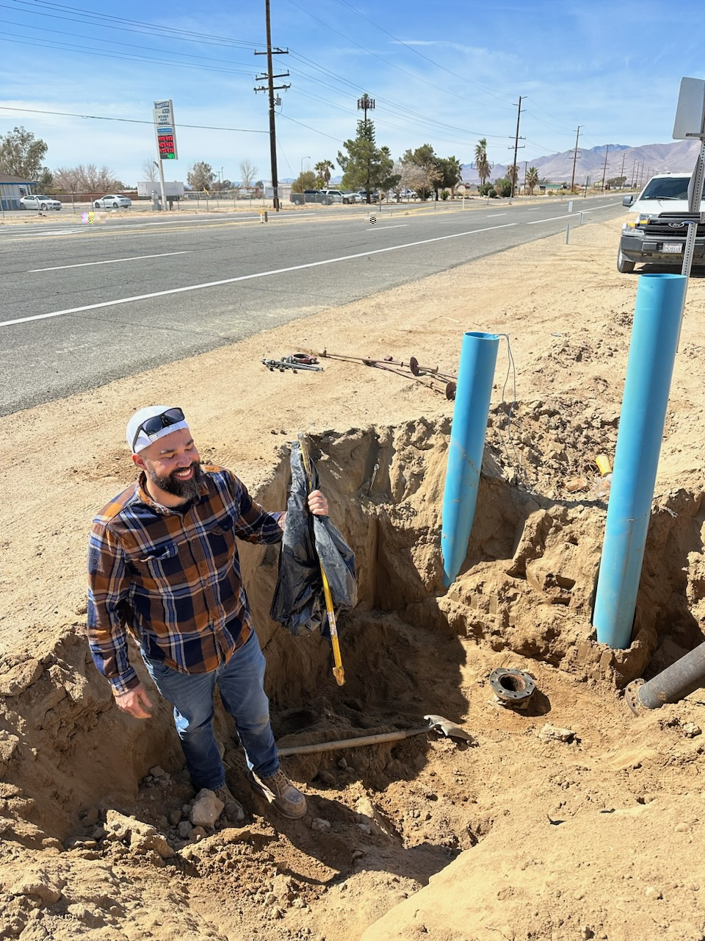

Slide 22
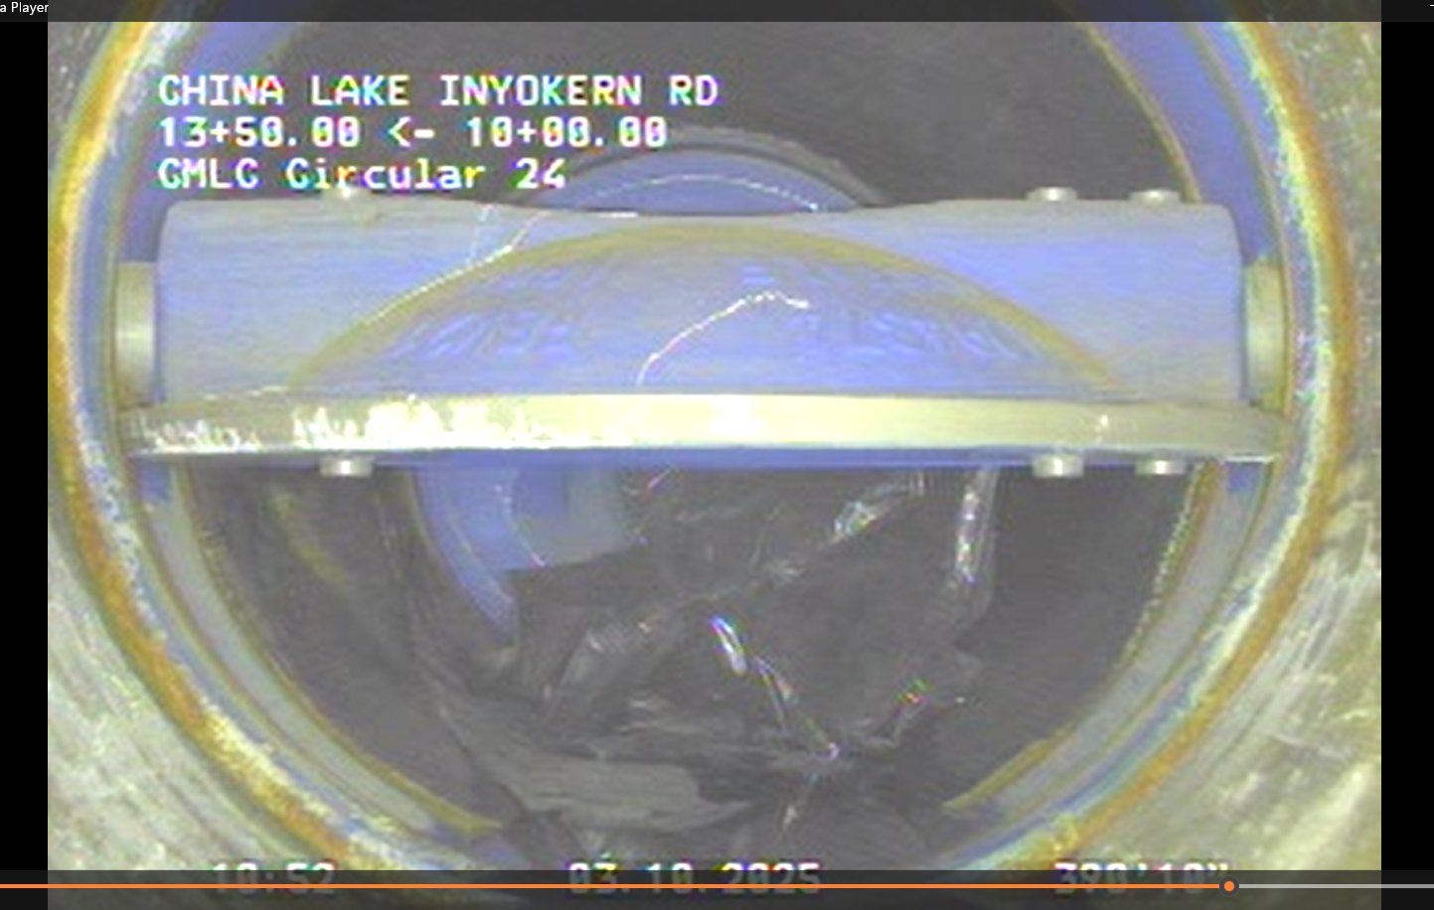

Slide 23
Staff Updates
Engineering
5. Water Systems Consolidations Update
Dune 3: Legal is working on the language of the agreement between Dune 3 and the District. Virtual kick-off meeting with GHD held last week. State is also reviewing the right of entry agreement that will be needed for both Dune 3 and the Hometown projects.
Hometown: Potholing to finish the Hometown design was completed and the design should be completed within 2 weeks.
Rademacher: Potholing completed for Phase 2. Preliminary pipeline alignment under review by Staff. Two of five easement documents signed/filed.
Serving Our Community for over 60 Years

Slide 24
Staff Updates
Financial
6. Financial Status
Description: Report on the District’s current financial status.
Serving Our Community for over 70 Years

Slide 25
Financial Breakout
Serving Our Community for over 60 Years

Slide 26
Financial Breakout
Serving Our Community for over 60 Years

Slide 27
Staff Updates
Operations
7. Arsenic Treatment Facilities
Description: Staff will update the Board on Maintenance Issues and production.
Plant 2 media removed, repairs ongoing, installation of replacement media to follow
8. Operations
Description: Staff report on Operations
8 replacements 7 repairs
0 NO-DES (9,501,562g)
1 Valve (14 YTD)
GIS continues Water Supply testing
Serving Our Community for over 70 Years

Slide 28
Board Comments/Future Agenda Items
Date of Next Regular Board Meeting:
April 14, 2025
Adjournment
Serving Our Community for over 70 Years

